Slide 1

Visualize voting trends with more than 20 years of U.S. election data
Kristian Ekenes
NACIS Annual Meeting
Louisville, KY
October 16, 2025

Slide 2
This talk explores various approaches to visualizing voting trends in U.S. presidential elections from 2000-2024 using an interactive web map. The app allows users to view election results from year to year using animations and composite multivariate symbols. I’ll introduce a map style that combines results from multiple elections into a single symbol, making it easy to see how support for a political party grew, shrunk, or maintained constant support over time in various regions of the United States. I’ll summarize the strengths and weaknesses of each visualization approach and propose when each visualization style is appropriate for specific audiences and situations.

Slide 3
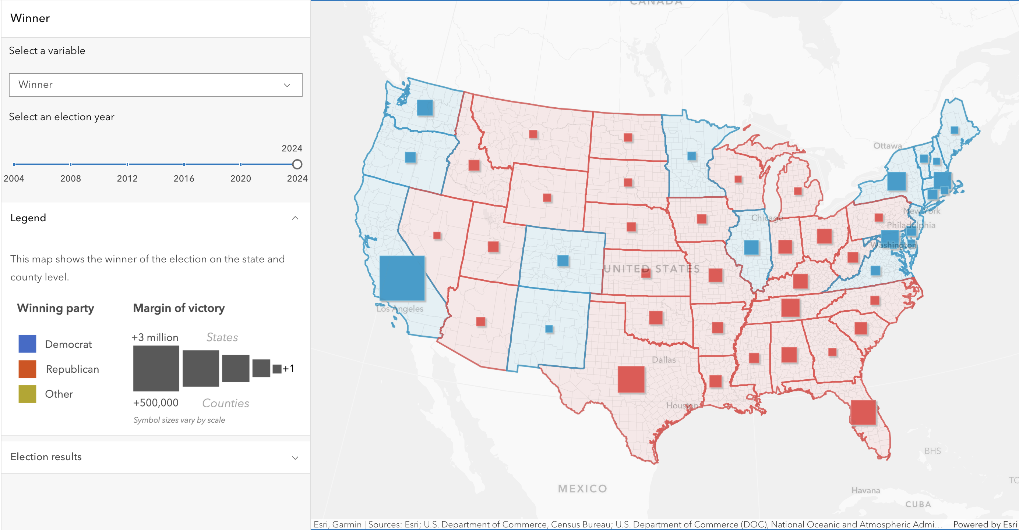

Slide 4
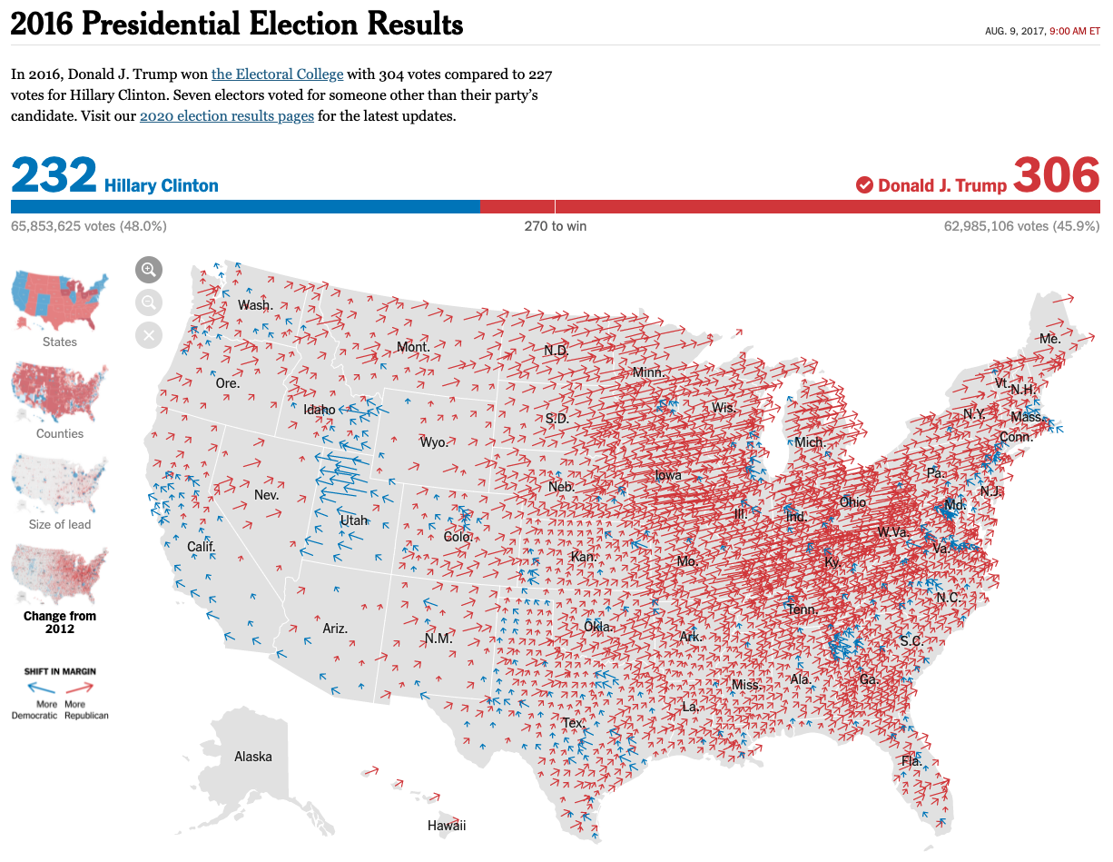
The New York Times

Slide 5
The New York Times

Slide 7
ff

Slide 8
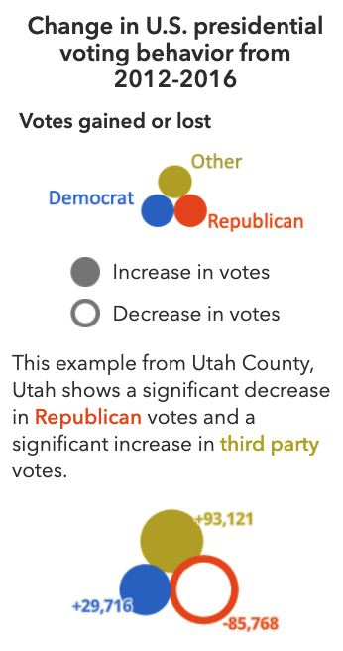
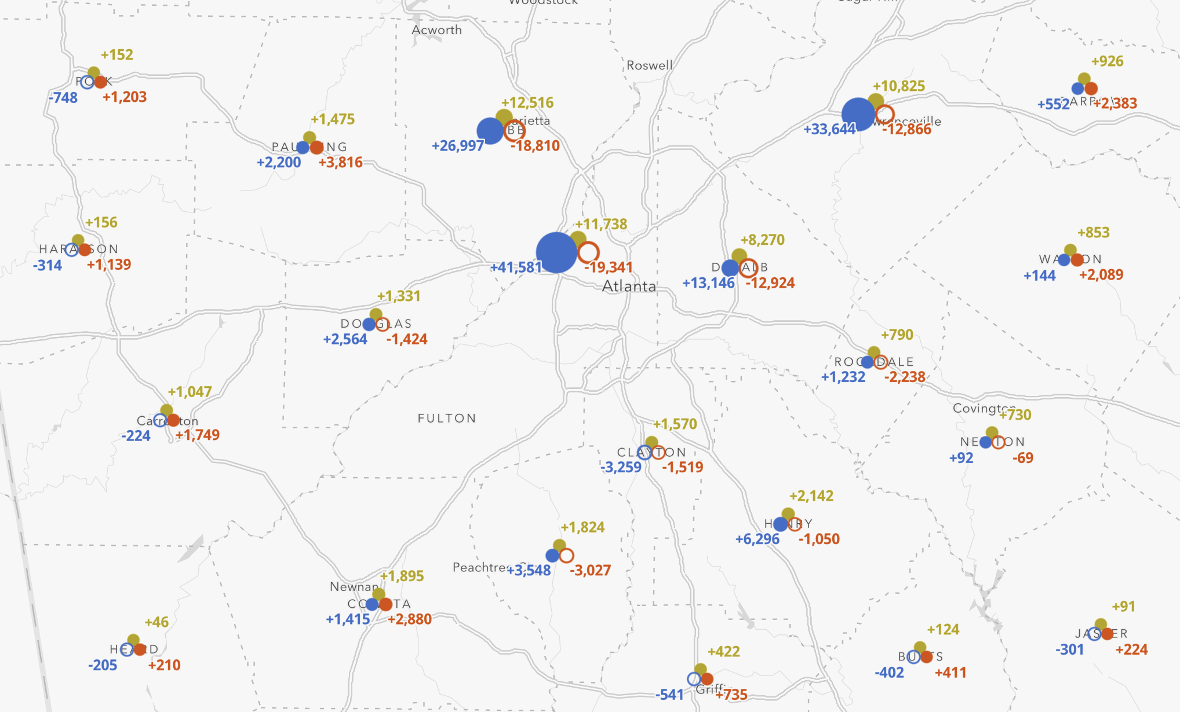

Slide 9
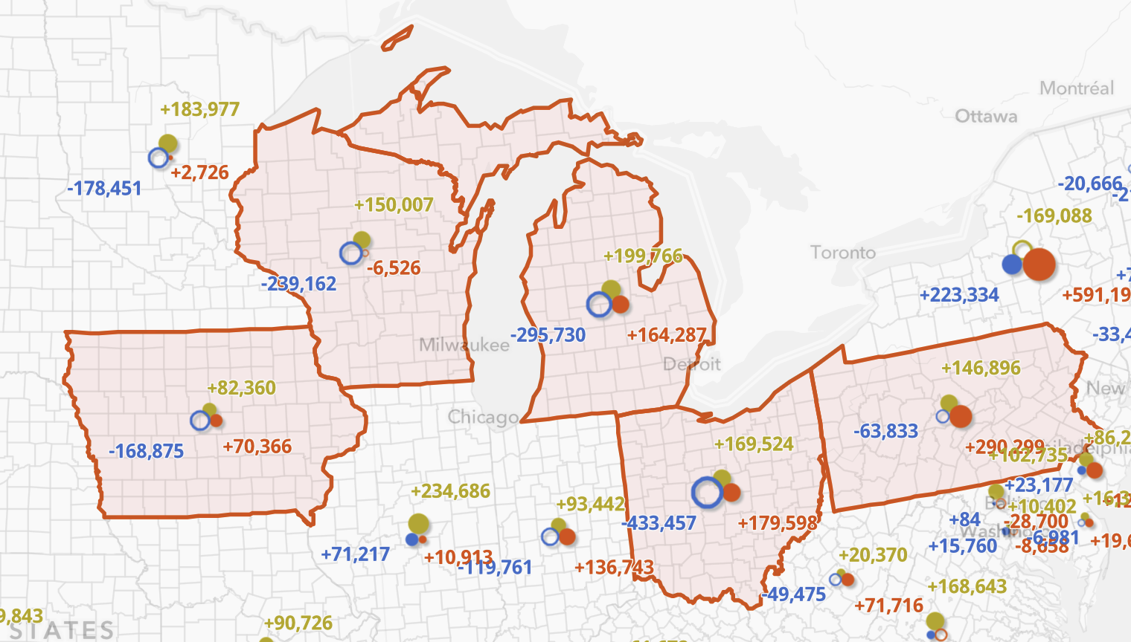

Slide 10
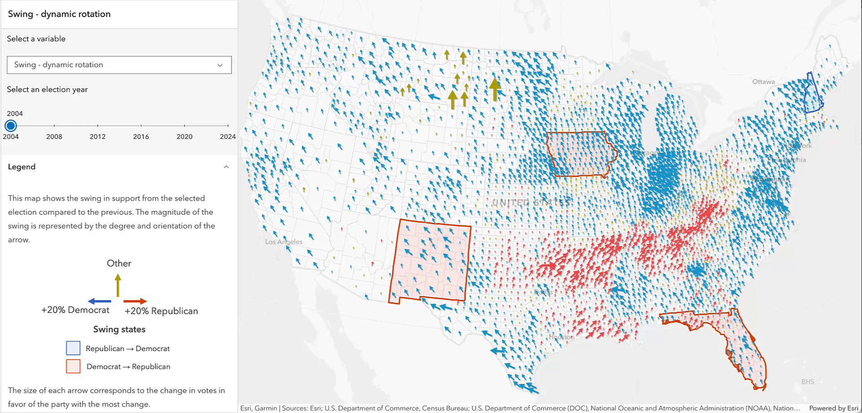

Slide 11
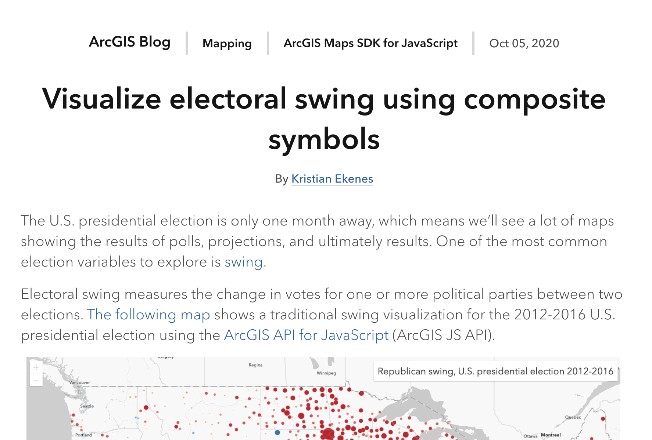
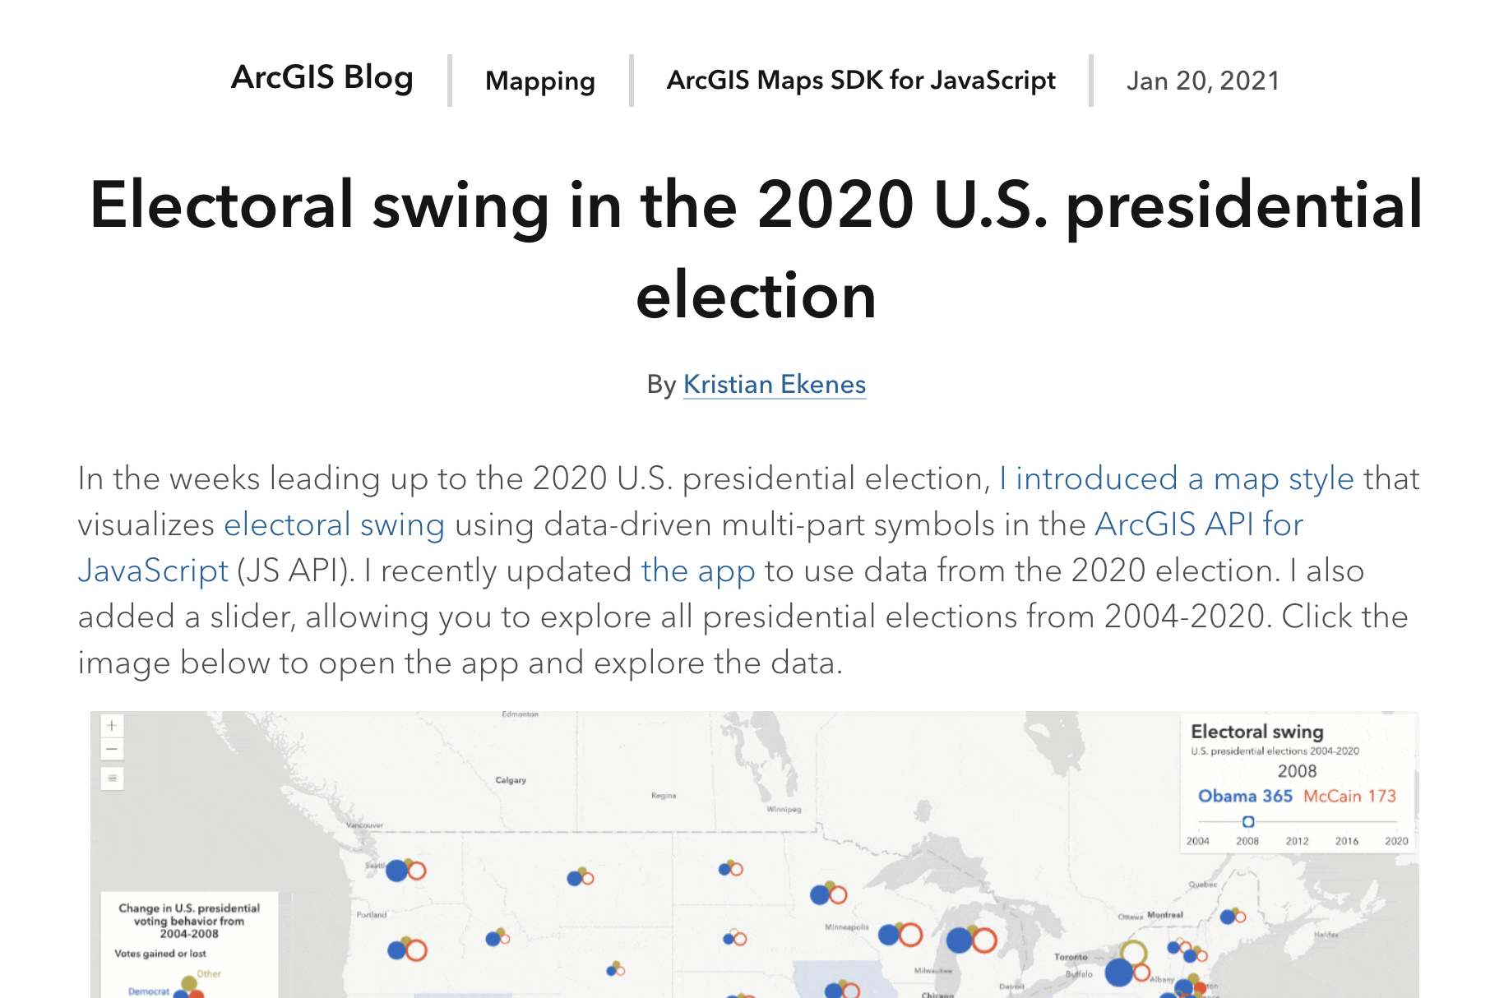
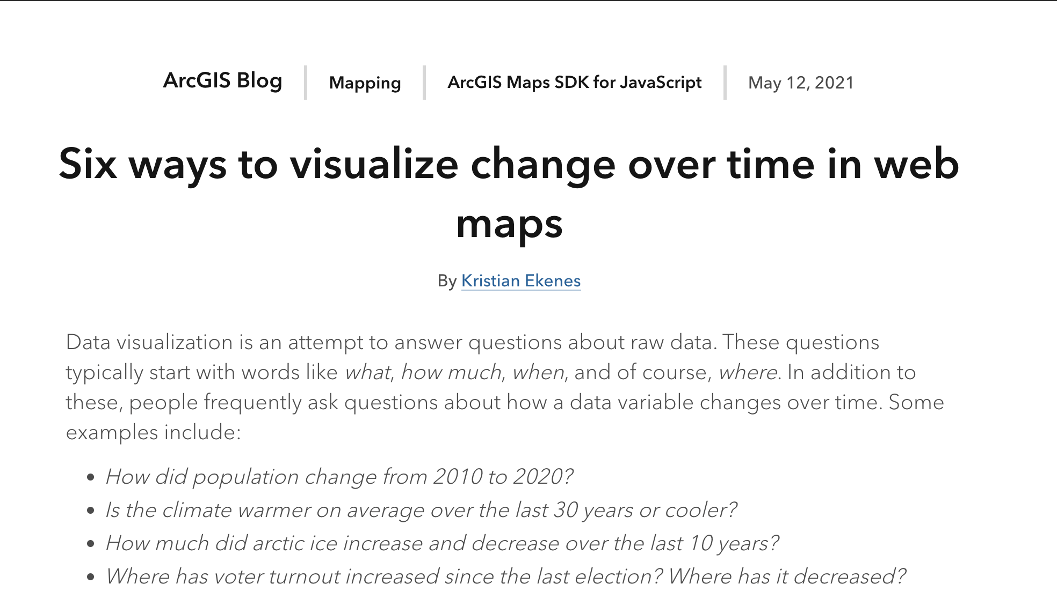

Slide 12
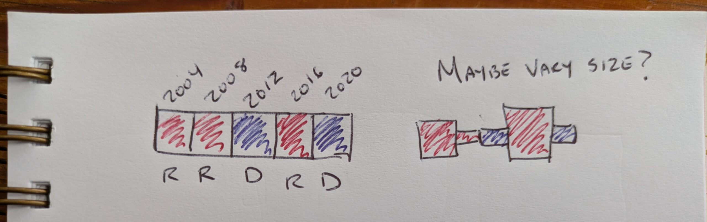

Slide 13
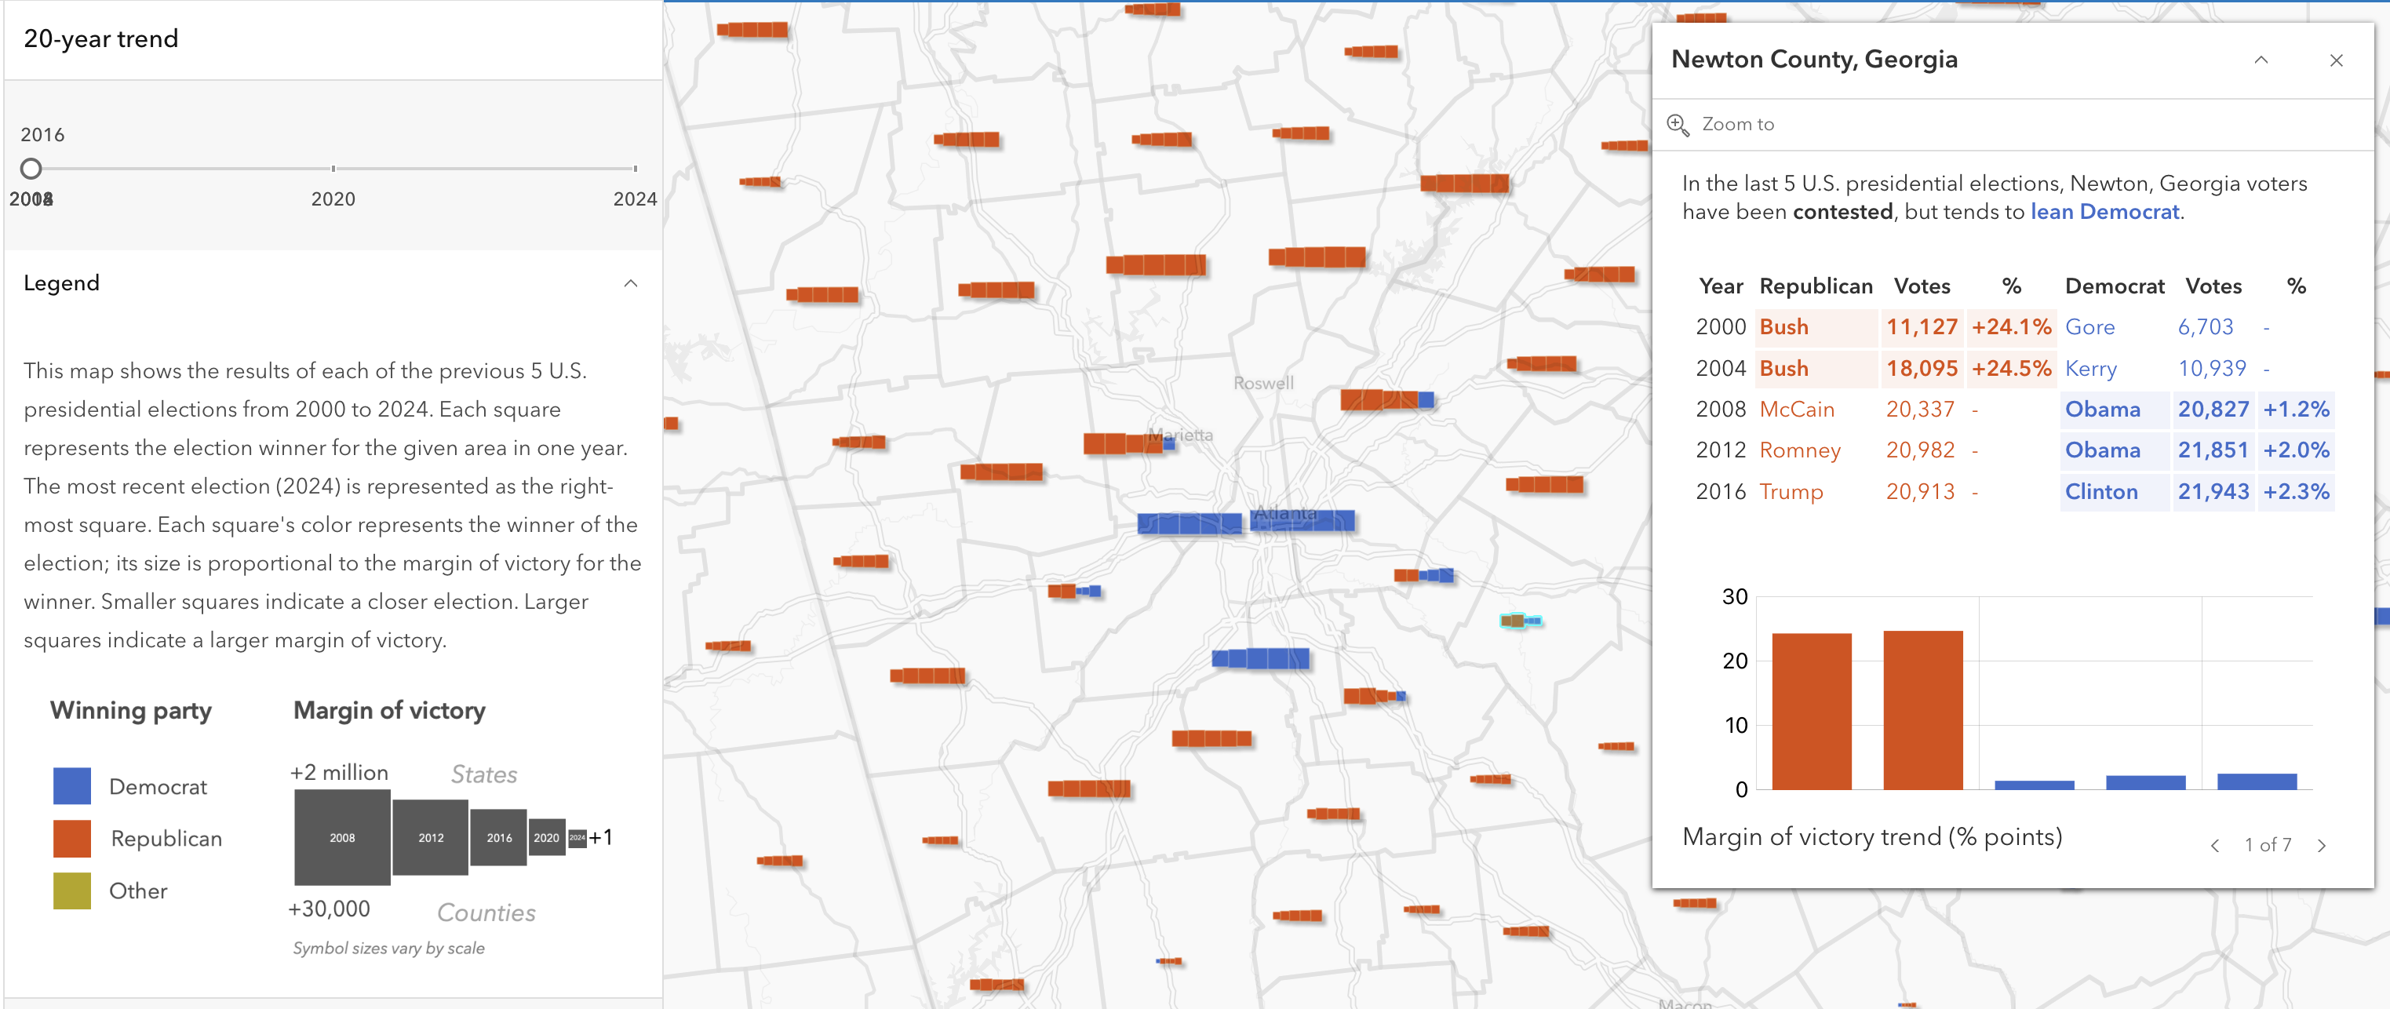
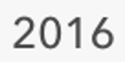

Slide 14
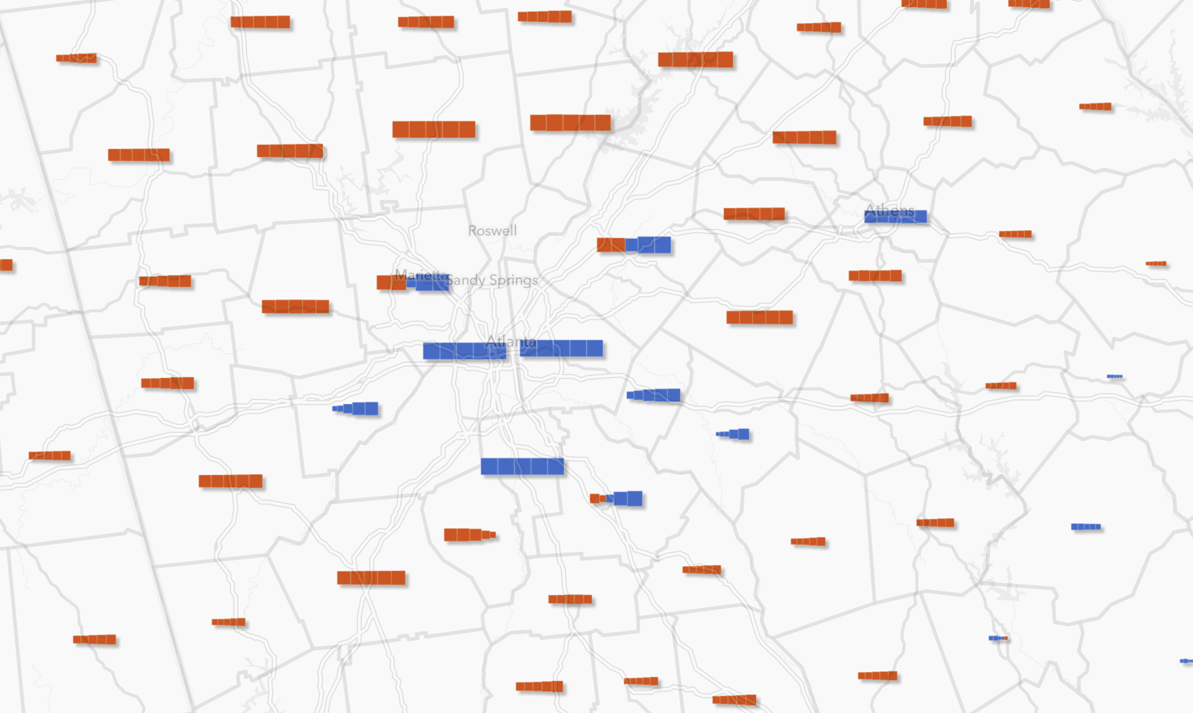
Demo

Slide 15
How it’s made
The web application

Slide 16
1. Create a web map in ArcGIS Online Map Viewer
Winner + margin
Add time series Arcade expression returning winner
Add time series Arcade expression returning margin of victory
Configure unique values style
Repeat process in step 1 for layers representing other variables
Winner + lean
Swing
Add layers for composite symbols with minimal/default symbology (the UI for configuring this doesn’t exist in Map Viewer)
Vote change per party – add layer, but with no renderer config
Trend boxes – add layer, but with no renderer config
Time series Arcade expressions allow you to update a layer’s renderer using a time slider to point to fields representing data at different time periods that correspond to time slider values.
Opposed to traditional time series visualizations, this technique does NOT filter data or alter layer visibility.

Slide 17
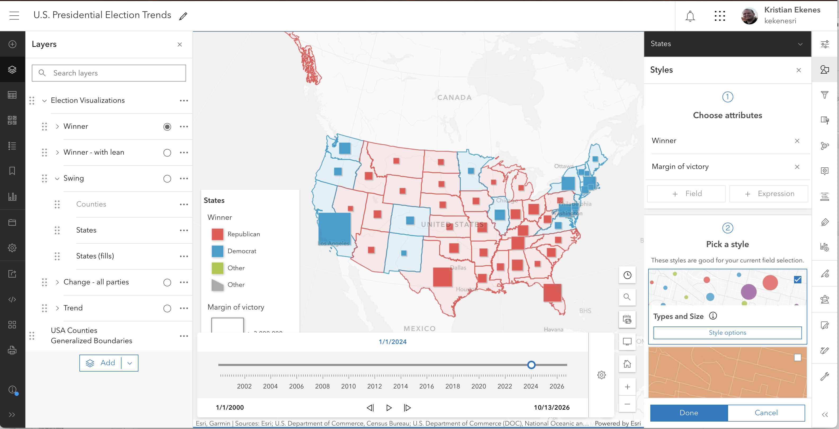

Slide 18
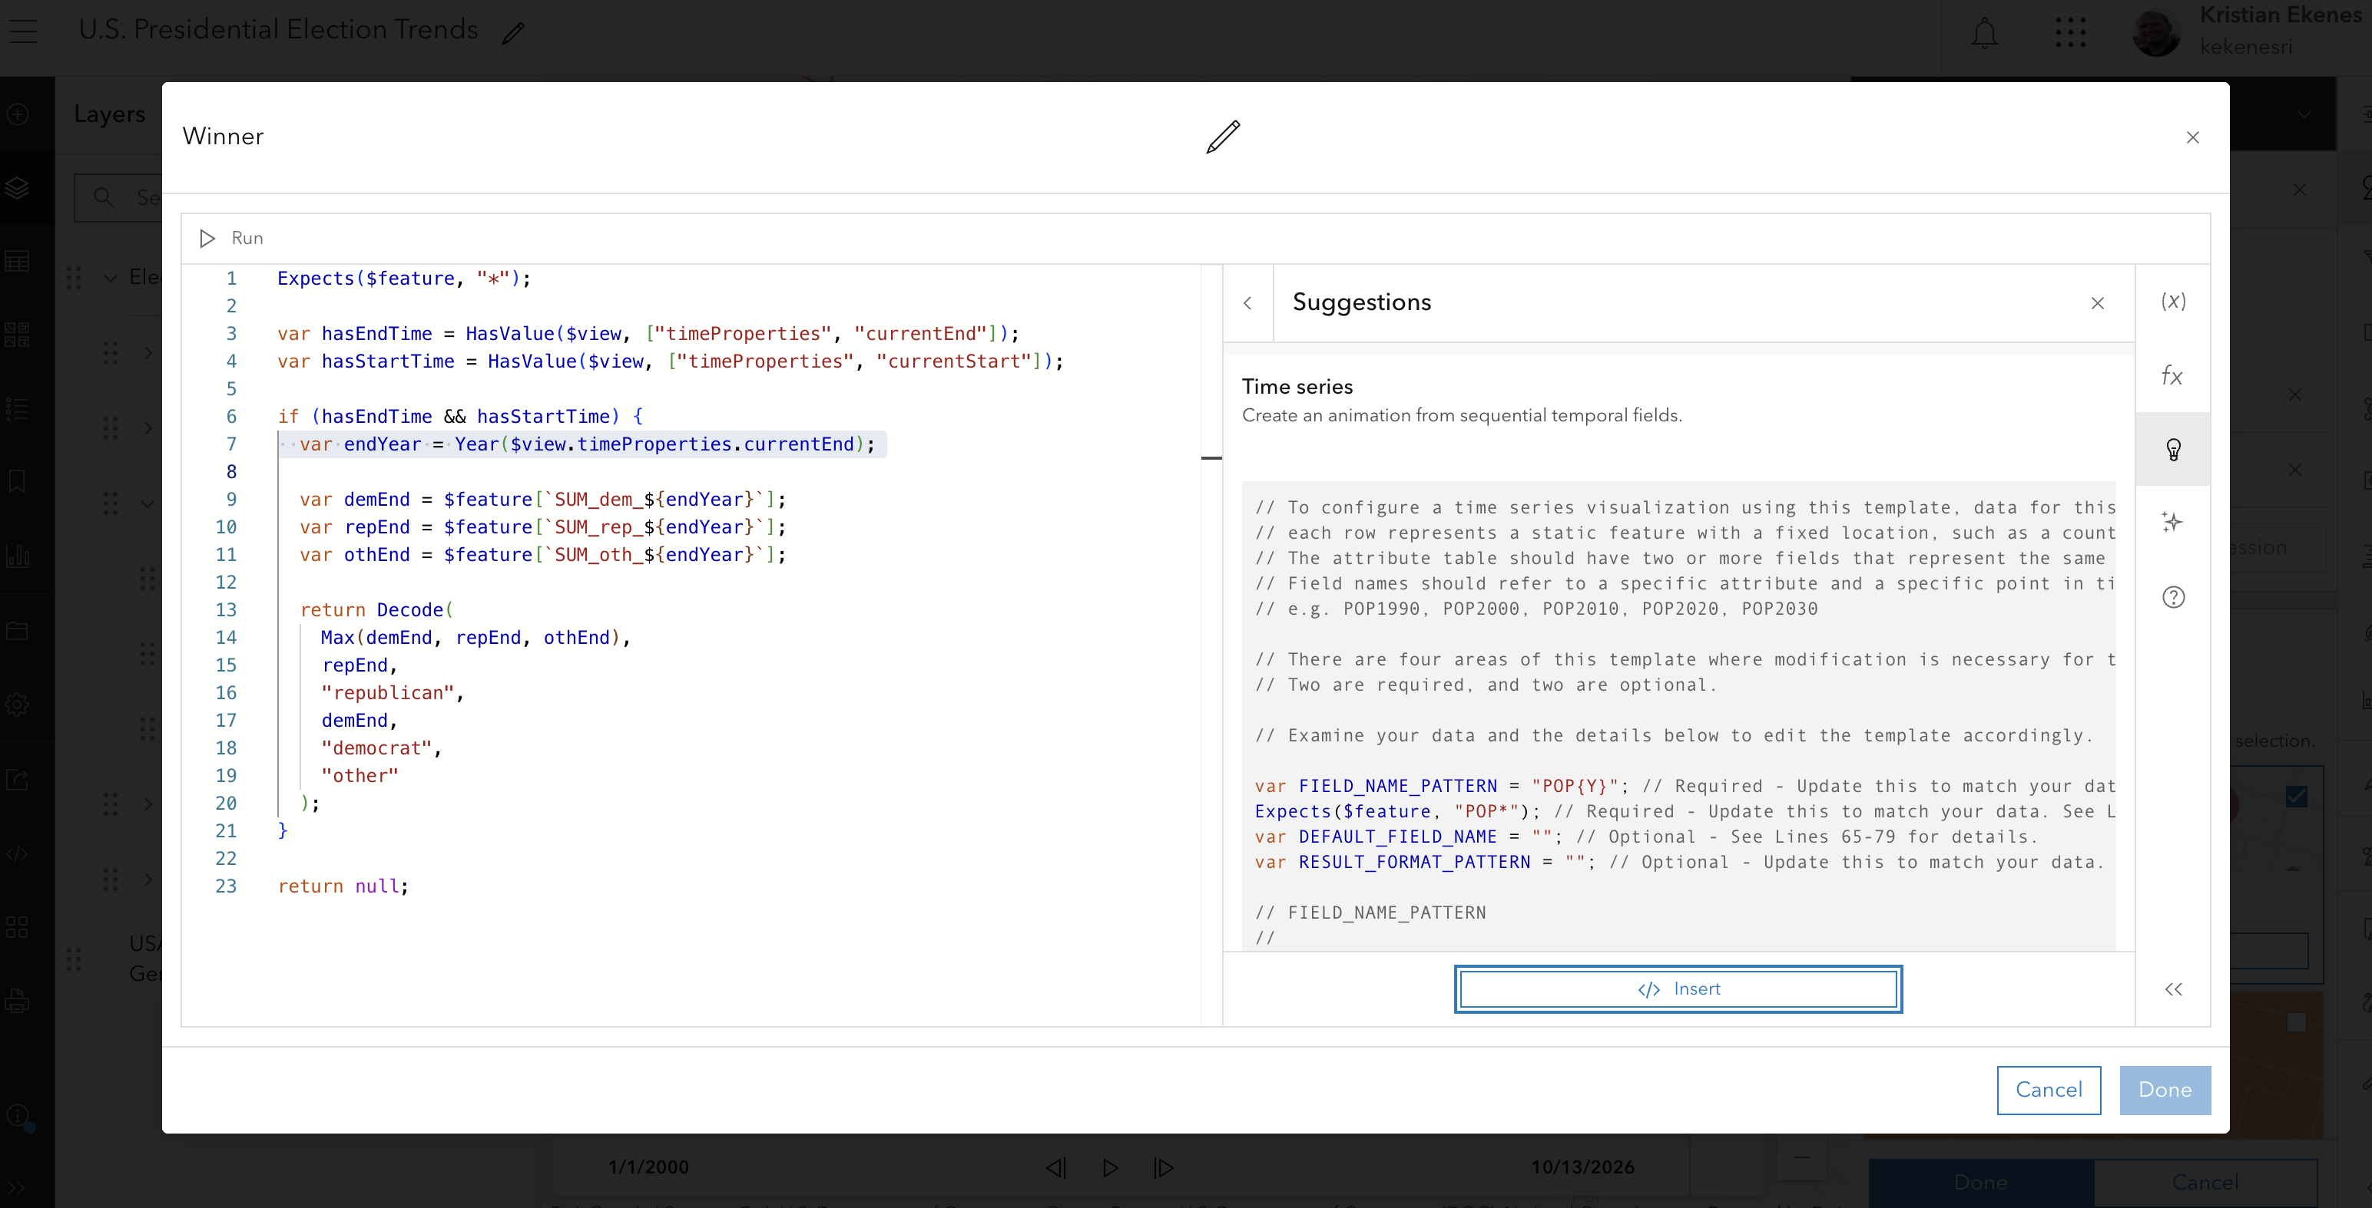

Slide 19
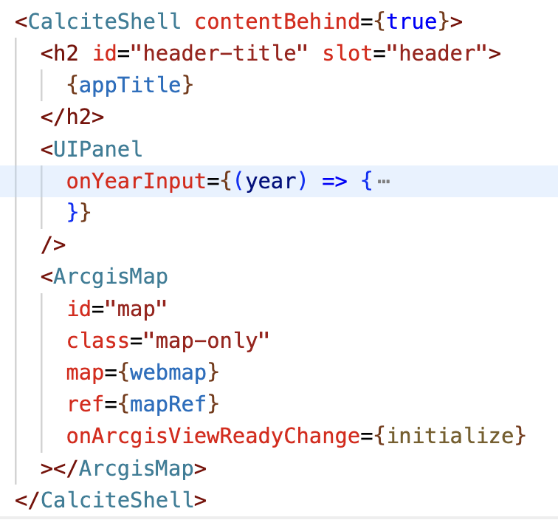
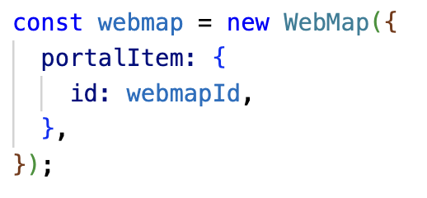
2. Create a web application using ArcGIS JS SDK
Load web map JSON in Map component
Build UI using Calcite components
Slider for animation
Custom legend for symbols not supported by OOB legend
Use @arcgis/core to create custom symbology for layers not able to be configured in Map Viewer.

Slide 20
3. Create custom styles not available in ArcGIS Online
Change in votes for each party
Trend

Slide 21
How it’s made
The trend box symbols

Slide 22
1. Create a renderer
const customRenderer = new SimpleRenderer({
symbol: new CIMSymbol(), // define symbol here
label: "Counties" // this will appear next to the symbol in the legend
});

Slide 23
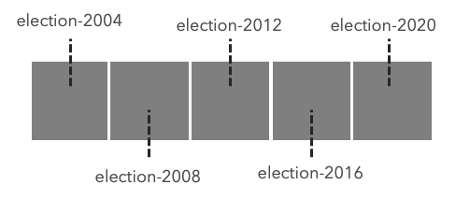
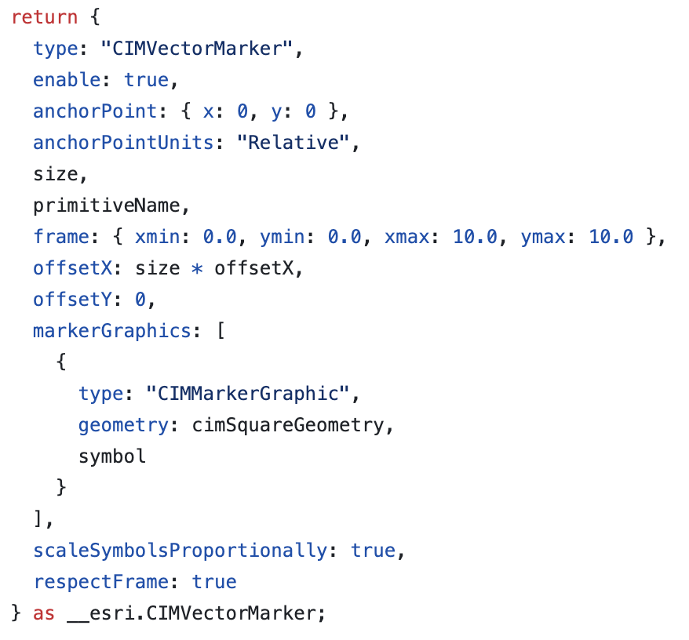
2. Create a CIMSymbol
primitiveName | offsetX
election-2004 | -2 * size
election-2008 | -1 * size
election-2012 | 0
election-2016 | 1 * size
election-2020 | 2 * size

Slide 24
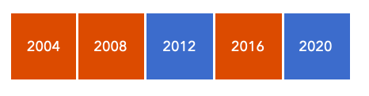
3. Define primitive overrides
Color – to show winner
var rColor = "rgba(220, 75, 0, 1)";
var dColor = "rgba(60, 108, 204, 1)";
var oColor = "rgba(181, 166, 0, 1)";
var demVotes = $feature.SUM_dem_2016;
var repVotes = $feature.SUM_rep_2016;
var othVotes = $feature.SUM_oth_2016;
var allVotes = [demVotes, repVotes, othVotes];
Decode( Max(allVotes), demVotes, dColor, repVotes, rColor, oColor );
const colorOverride = {
type: "CIMPrimitiveOverride",
primitiveName: "election-2016",
propertyName: "Color",
valueExpressionInfo: {
type: "CIMExpressionInfo",
title: "Winner",
expression: colorOverrideExpression,
returnType: "Default",
}
};

Slide 25
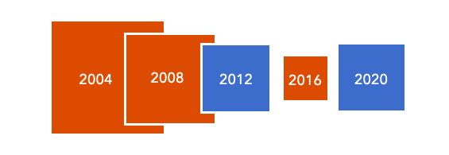
3. Define primitive overrides
var demVotes = $feature.SUM_dem_2016;
var repVotes = $feature.SUM_rep_2016;
var othVotes = $feature.SUM_oth_2016;
var allVotes = Reverse(Sort([demVotes, repVotes, othVotes]));
var value = allVotes[0] - allVotes[1];
var sizeFactor = When(
value >= 2000000, 32,
value >= 500000, 16 + (0.0000107 * (value - 500000)),
value >= 100000, 8 + (0.00002 * (value - 100000)), value >= 10000, 4 + (0.000044 * (value - 10000)),
value > 0, 2 + (0.0002 * value), 0 );
var scaleFactorBase = (18489200 / $view.scale); var scaleFactor = When(
scaleFactorBase >= 0.5, scaleFactorBase * 0.6,
scaleFactorBase >= 0.25, scaleFactorBase * 0.45,
scaleFactorBase >= 0.125, scaleFactorBase * 0.3125,
scaleFactorBase * 0.1875 );
return sizeFactor * scaleFactor;
Size – to show margin of victory
const sizeOverride = {
type: "CIMPrimitiveOverride",
primitiveName: "election-2016",
propertyName: "Size",
valueExpressionInfo: {
type: "CIMExpressionInfo",
title: "Margin of Victory",
expression: sizeOverrideExpression,
returnType: "Default",
}
};

Slide 26
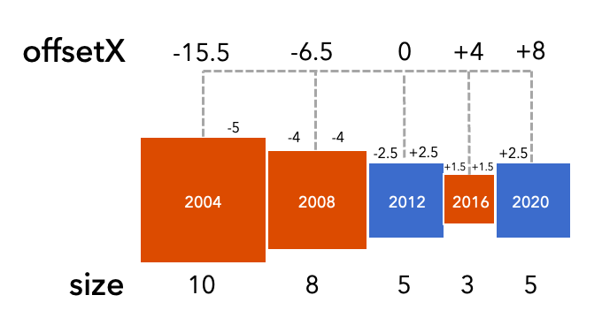
3. Define primitive overrides
OffsetX – to properly place symbol layers so they are adjacent

Slide 27
3. Define primitive overrides
OffsetX – to properly place symbol layers so they are adjacent
primitiveName | offsetX
election-2004 | -1 * ((0.5 * election2004size) + election2008size + (0.5 * election2012size))
election-2008 | -1 * ((0.5 * election2008size) + (0.5 * election2012size))
election-2012 | 0
election-2016 | (0.5 * election2012size) + (0.5 * election2016size)
election-2020 | (0.5 * election2012size) + election2016size + (0.5 * election2020size)

Slide 28
3. Define primitive overrides
// a VERY abbreviated version of this…
var years = [2004, 2008, 2012, 2016, 2020];
var selectedYear = 2016;
var numItems = Count(years);
var isEvenItems = isEven(numItems);
var middleIndex = Floor(numItems / 2);
if (isEvenItems) { middleIndex -= 0.5; }
var index = IndexOf(years, selectedYear);
var direction = iif(index < middleIndex, -1, 1);
var yearStart = iif(direction < 0, selectedYear, years[middleIndex]);
var yearEnd = iif(direction < 0, years[middleIndex], selectedYear);
var sizes = [];
var offsetX = 0;
for (var year = yearStart; year <= yearEnd; year += interval) {
// insert size calculation here
var factor = iif( (year == yearStart) || (year == yearEnd), 0.5, 1 );
offsetX += (size * factor);
}
return offsetX * direction;
OffsetX – to properly place symbol layers so they are adjacent
const colorOverride = {
type: "CIMPrimitiveOverride",
primitiveName: "election-2016",
propertyName: ”OffsetX",
valueExpressionInfo: {
type: "CIMExpressionInfo",
title: "Winner",
expression: offsetXOverrideExpression,
returnType: "Default",
}
};

Slide 29
A review of each style

Slide 30
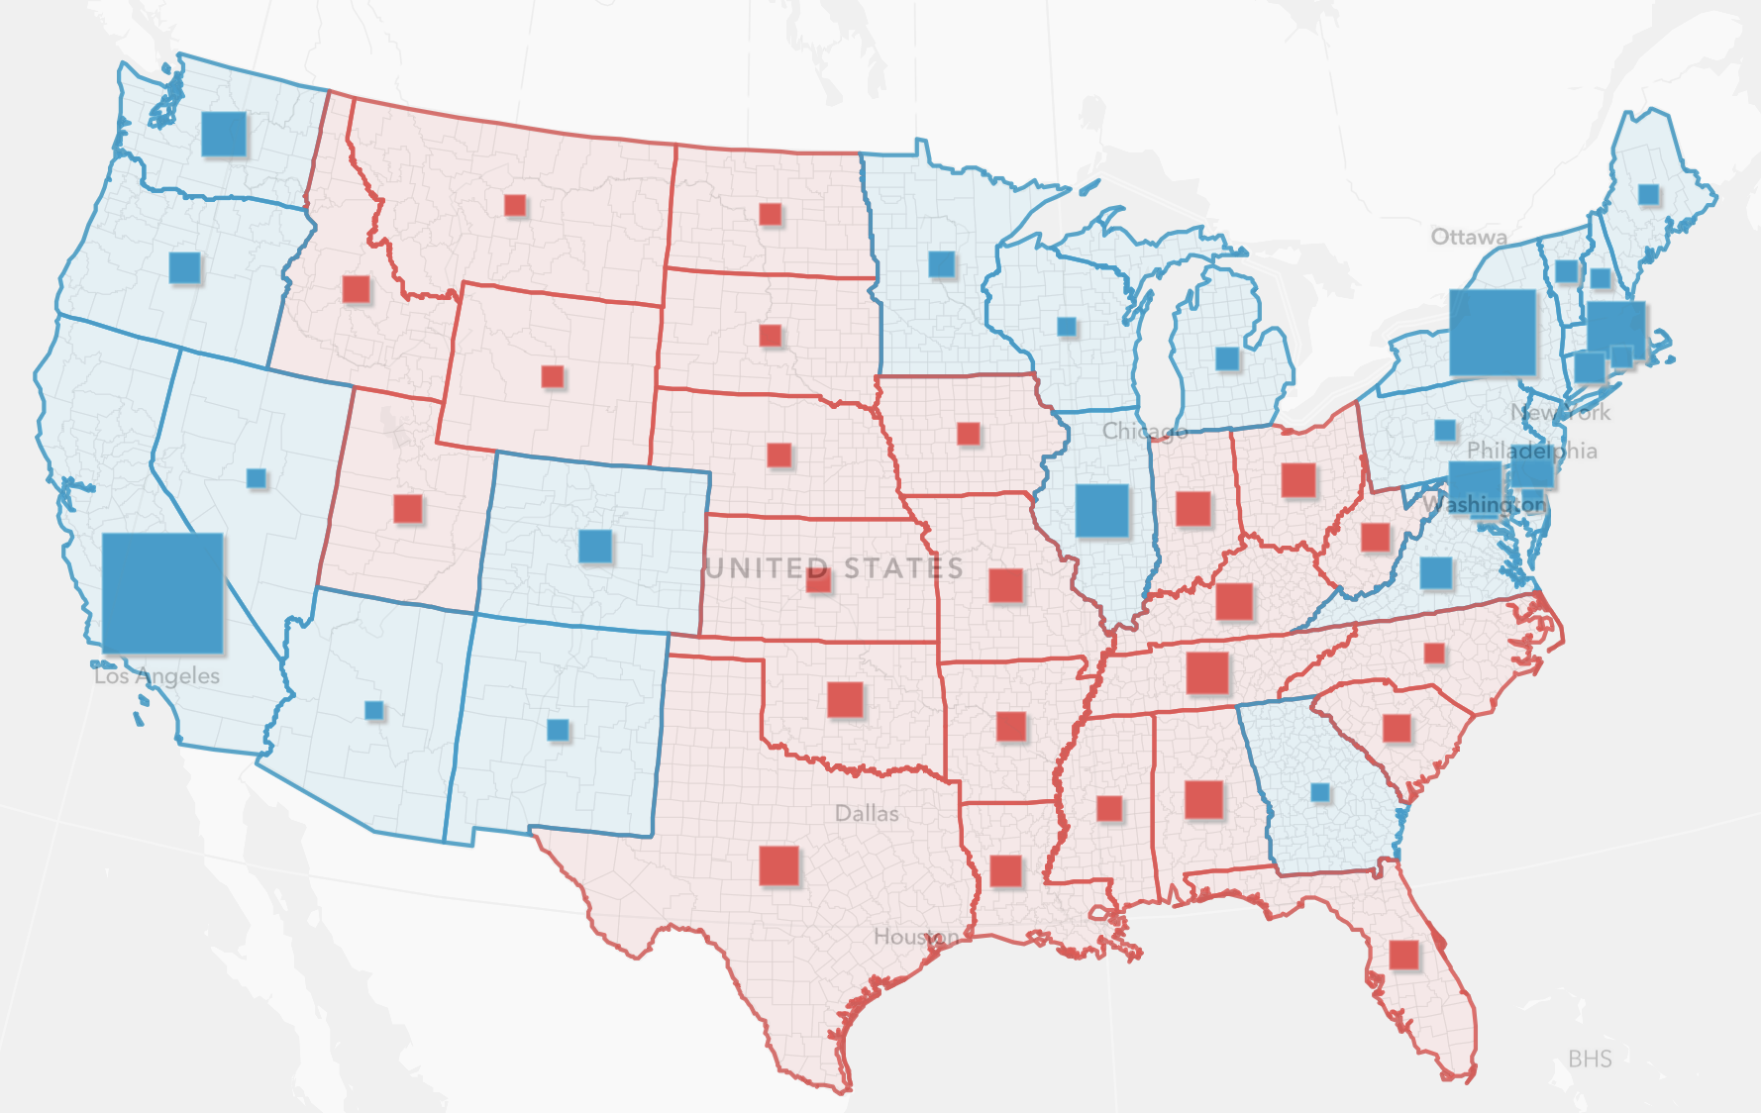
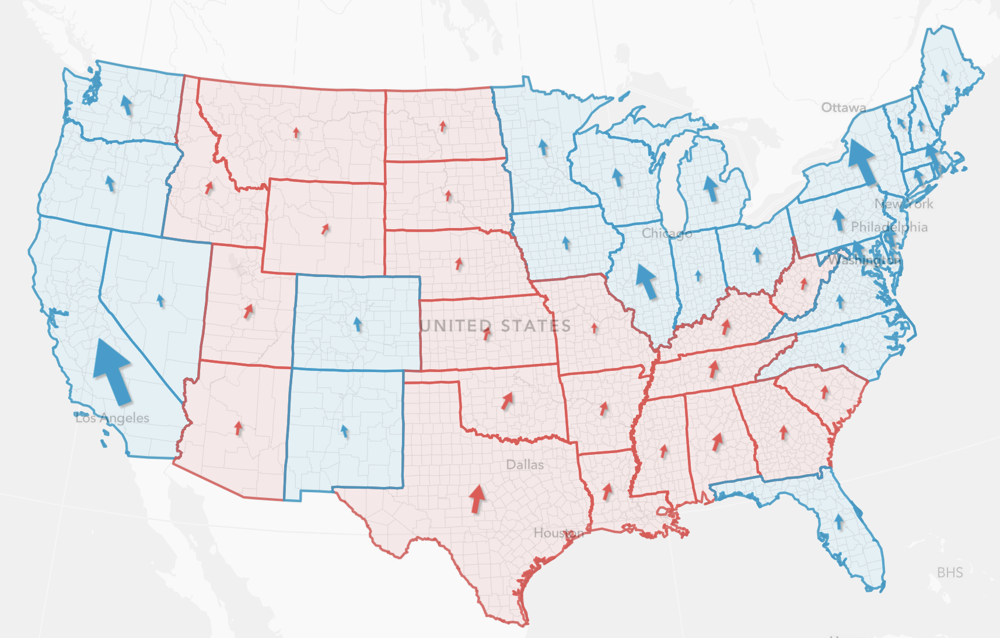
Winner + margin and winner + lean
Strengths
Showing who won
Low cognitive effort for seeing year-to-year winner
Good for short attention spans
Quick to grasp
Each frame has familiarity with general audiences
Weaknesses
Showing overall trend
Difficult to see slight regional changes that have major impact
e.g. individual counties influencing electoral votes
One year visible at a time
Seeing trend requires high cognitive effort
Requires toggling slider values back and forth at different stops

Slide 31
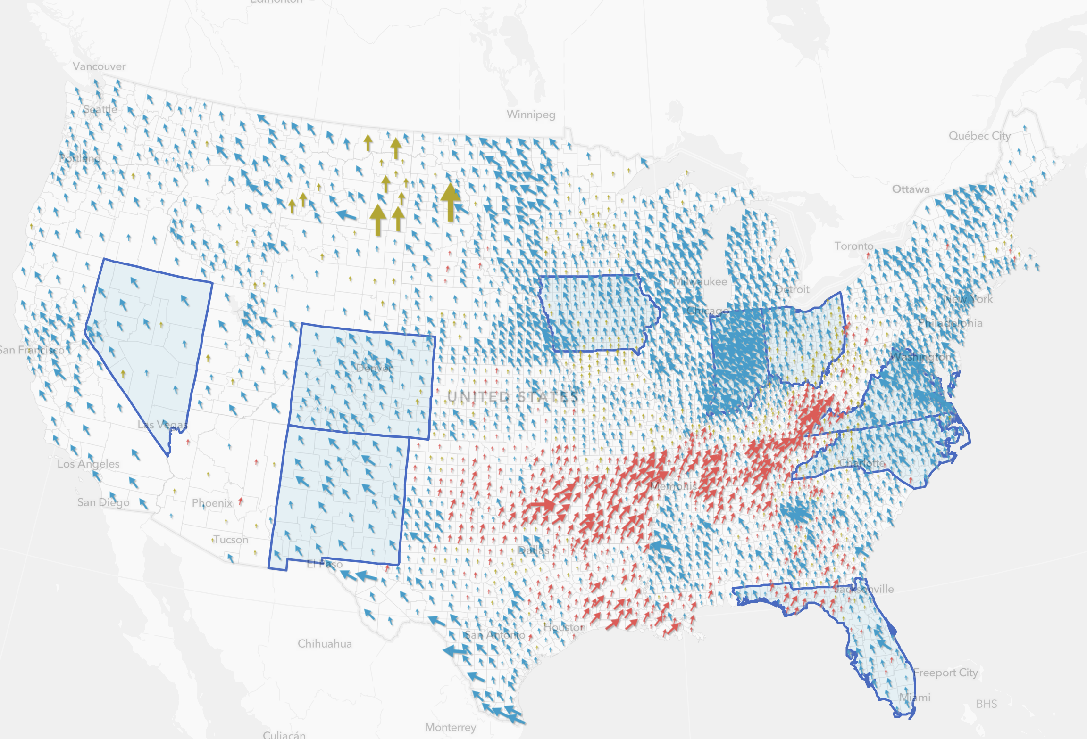
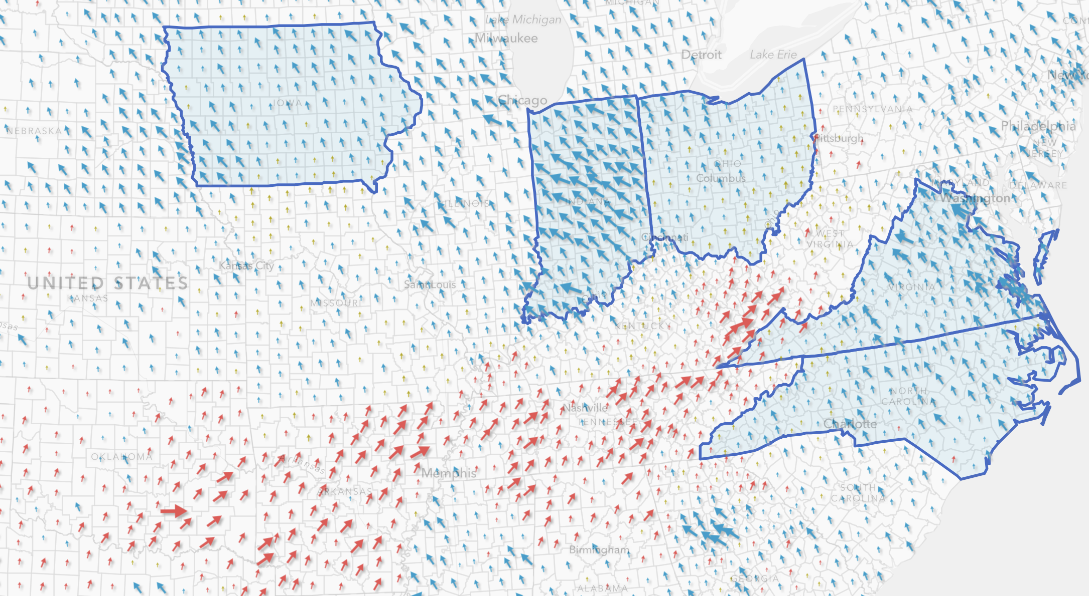
Swing
Strengths
Showing predominant change in voting behavior
Easy to see party swings and dramatic changes in a given year
Good for short attention spans
Weaknesses
High cognitive effort for seeing year-to-year winner
Difficult to see slight regional changes that have major impact
e.g. individual counties influencing electoral votes
Seeing trend requires high cognitive effort
Requires toggling slider values back and forth at different stops

Slide 32
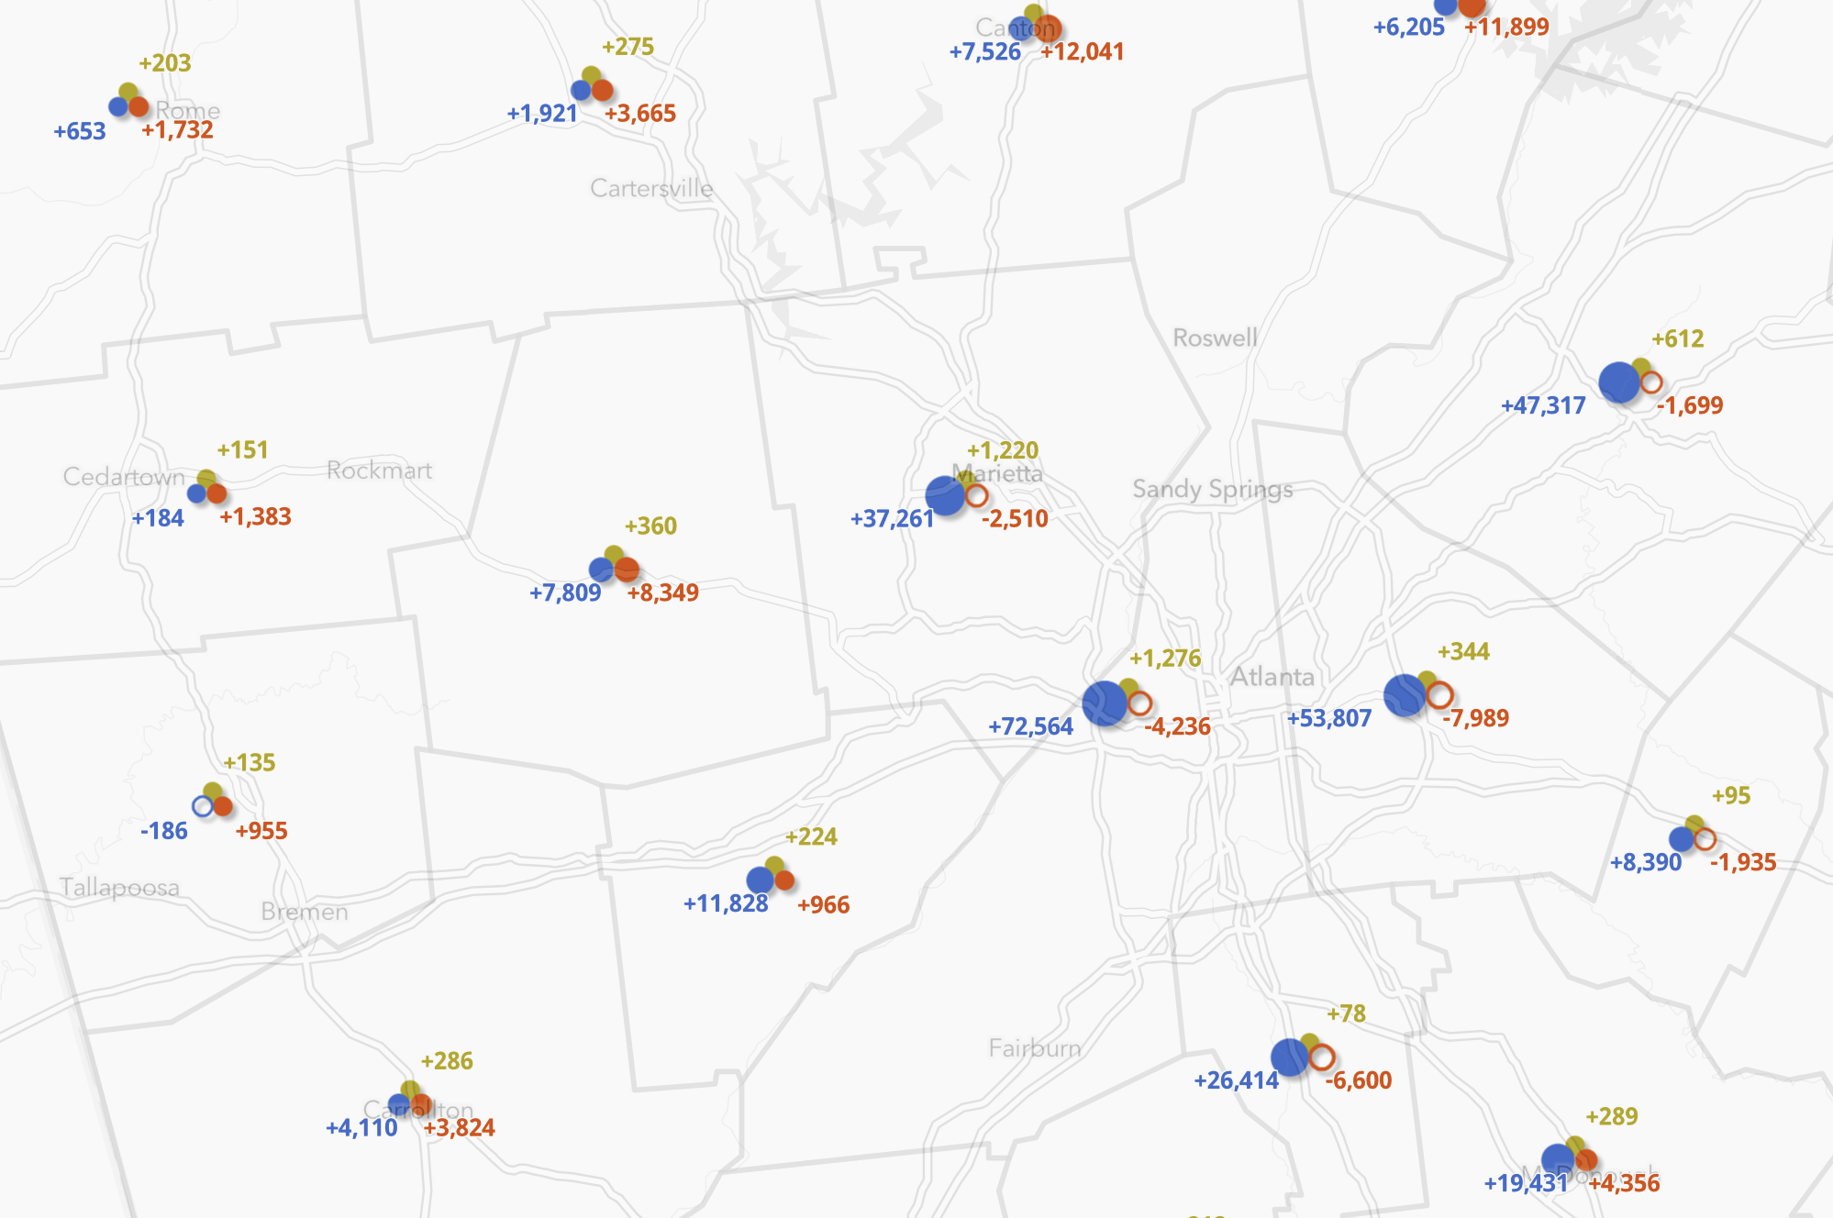
Composite symbols: change in votes for all parties
Strengths
Showing detailed nuances of voting shifts in different parties year to year
e.g. individual counties influencing electoral votes
Easy to see party swings, and dramatic changes using slider.
Weaknesses
Showing who won
Initial view requires more cognitive effort
e.g. “what am I looking at?”
High cognitive effort for seeing year-to-year winner
Seeing trend requires high cognitive effort
Requires toggling slider values back and forth at different stops
Audiences with short attention spans

Slide 33
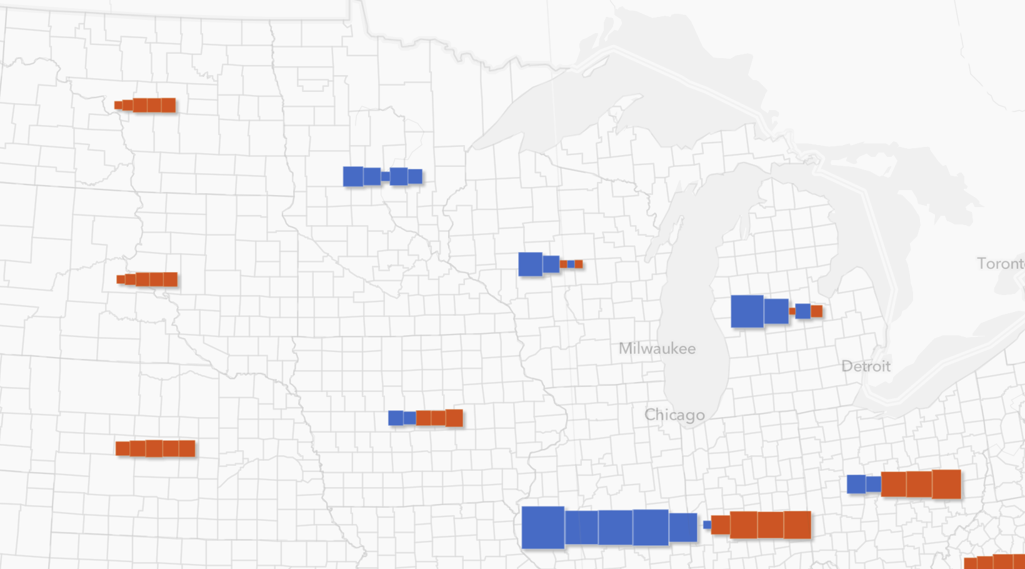
Trend boxes
Strengths
Seeing trend requires low cognitive effort
Can see trend at first glance. No slider interaction required.
Complements winner + margin style
Same foundational symbology in each symbol part
Easy to see party swings, and dramatic changes
Good at showing outliers that wouldn’t be considered part of a trend
Weaknesses
Initial view requires more cognitive effort
e.g. “what am I looking at?”
Audiences with short attention spans
Symbol overlap – no deconfliction
Size variations can be difficult to perceive (similar to graduated size)

Slide 34
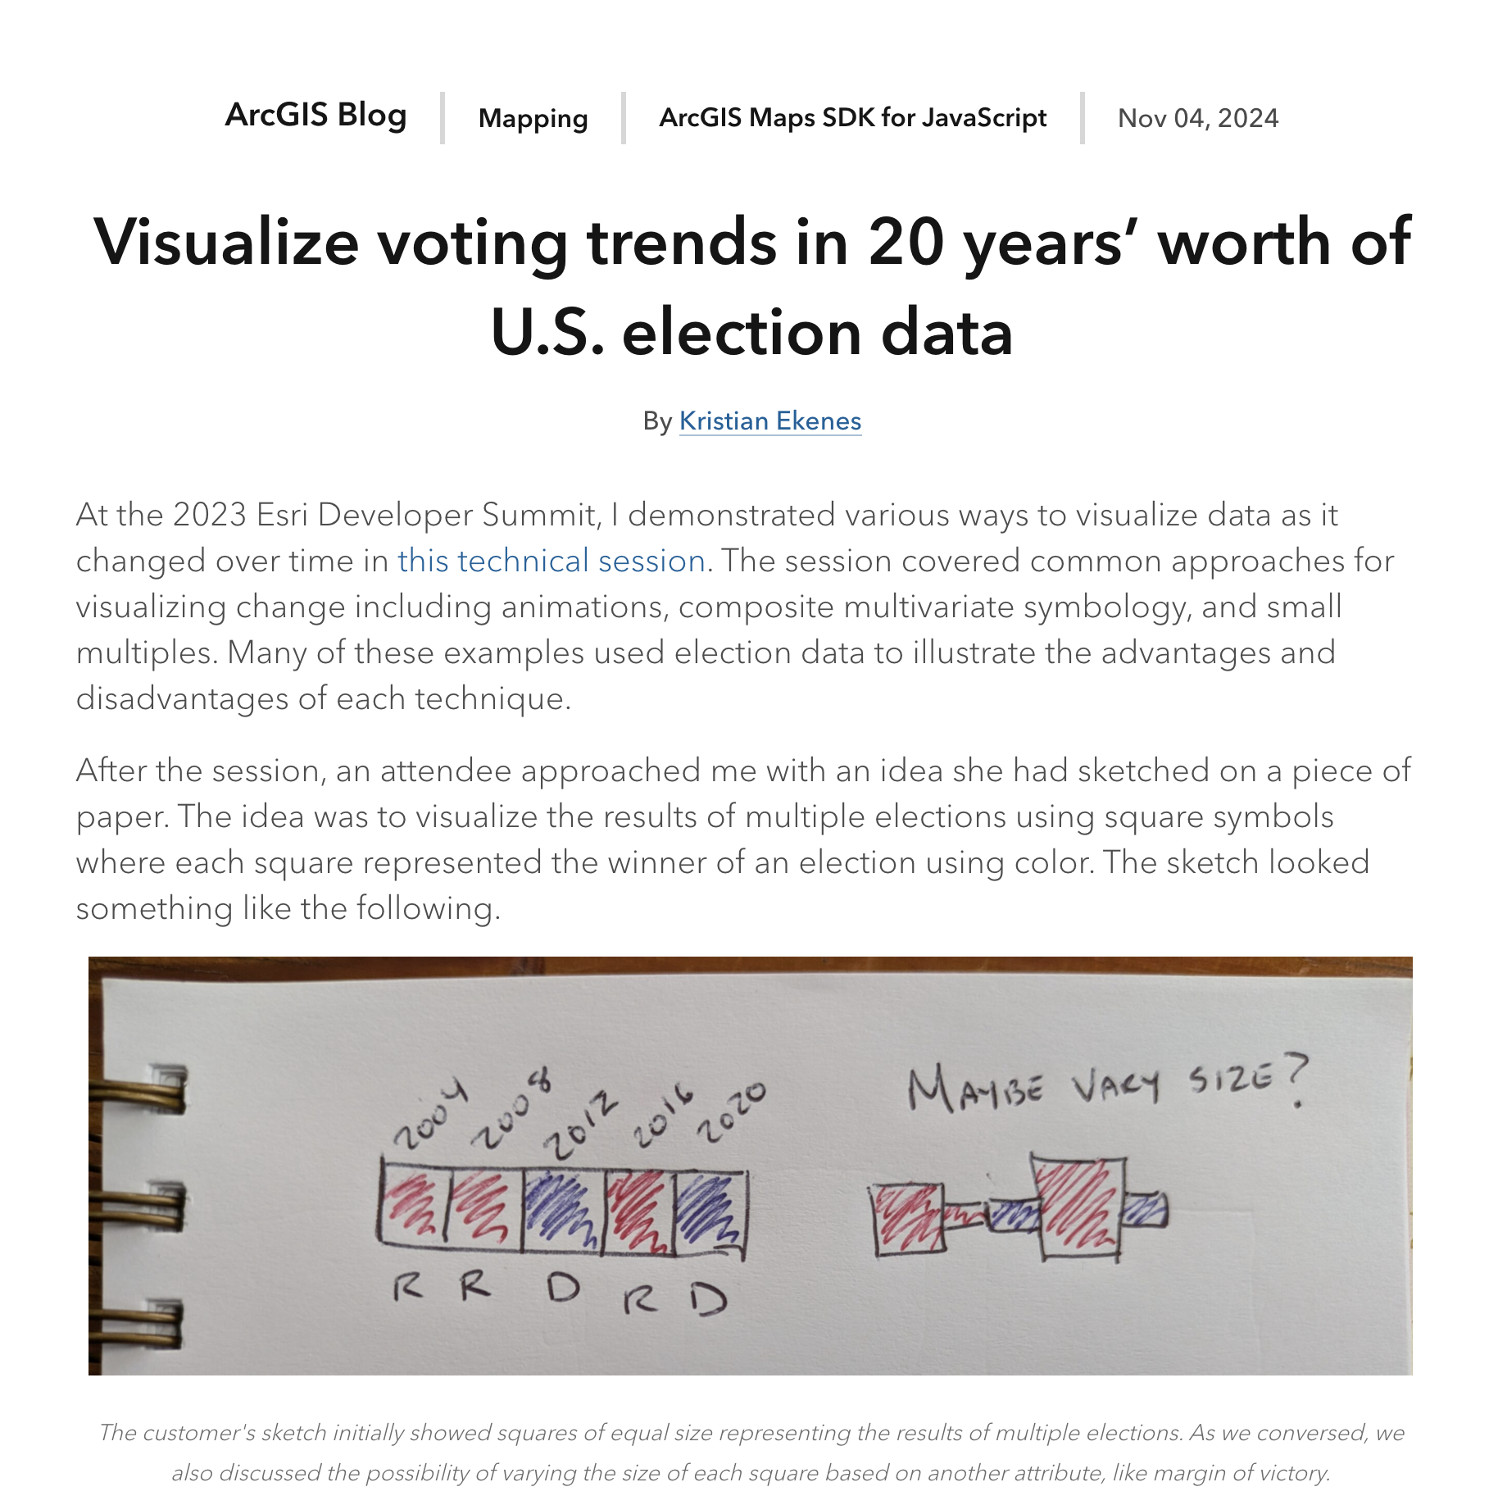

Slide 35
In summary
Exploring a map is a lot like reading
Pamphlets, signs, news headlines, summaries, etc.
Use styles that require low cognitive effort
Novels, long-form articles, textbooks
Requiring more cognitive effort is OK here
Trend style is best suited for folks willing to take the time to explore the data
Allows me to “get lost” in a map to learn and discover something new

Slide 36
Other ways of visualizing trends
Spark lines
Not great for categorical data. Fine with a few features. Difficult for lots of features.
Waffle grids
Good for categorical data, but a lot (more) to digest
Small multiples
Good for print, hard as interactive web maps
Choropleth
Diverging red-blue color ramp showing winner of most recent election with saturation of color varied by the number of elections that party won in a row.
Hides the nuances of the trend

Slide 37
Looking ahead – ArcGIS Online Map Viewer
Add time series configuration UI
No need to write Arcade
Hopefully available next year
Will evaluate potential of adding “Trend” as an out-of-the-box map style
Assess need, demand, design, level of effort, etc.

Slide 38





Thank you!
I welcome all feedback
Kristian Ekenes
kekenes@esri.com
kristian-ekenes
ekenes

